Slide 1
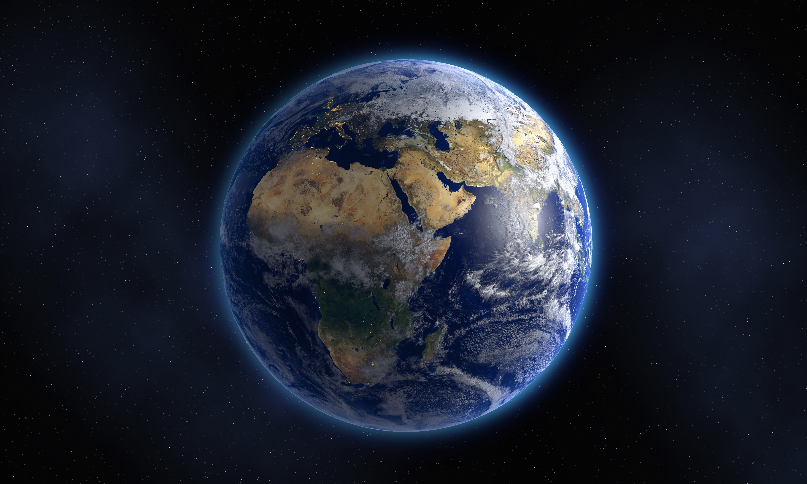
MISSION sPACE-X ETL Project
By Group # 4 -Phanit Tameerug, Savita Hirilall,
Tejal Kotkar, Hibo Dahir

Slide 2

SpaceX designs manufacture and launch advanced rockets and spacecraft.
SpaceX is a privately owned company founded by Elon Musk.
SpaceX has gained worldwide attention for a series of historic milestones by revolutionizing space transportation, with the goal of making life multiplanetary.

Slide 3
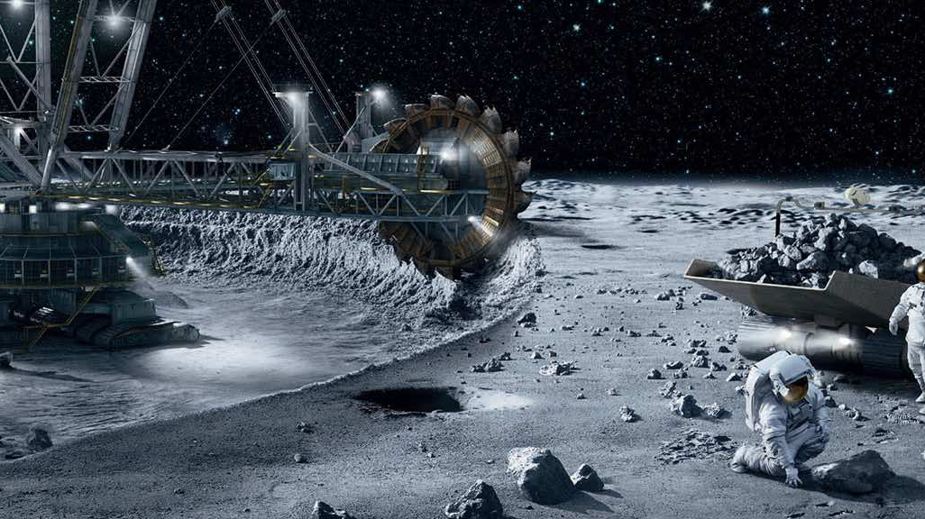
Extract
Data Source: Kaggle
https://www.kaggle.com/rohanrao/rspacex-data?select=cores.csv
From Kaggle picked five csv files that are from year 2006-2020:
Capsules, Launches, Launchpads, Payloads, Rockets
API data Source:
Capsules https://api.spacexdata.com/v3/capsules
Launches https://api.spacexdata.com/v3/launches
Launchpads https://api.spacexdata.com/v3/launchpads
Payloads https://api.spacexdata.com/v3/payloads
Rockets https://api.spacexdata.com/v3/rockets

Slide 4
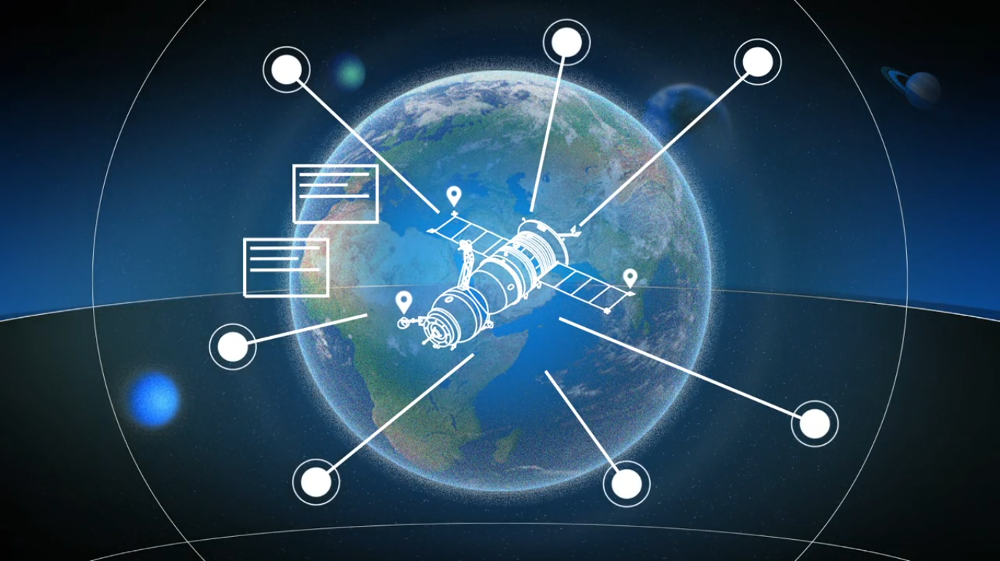
Data extracted from Kaggle was in the form of CSV files.
Additional data was extracted from API for each CSV file.
Extracted CSV files were loaded in Pandas dataframe.
Inspected dataframes and noted the data (column structure) that was missing and available in API.
Retrieved additional data from API for each respective dataframe.
Added new columns to Data Frame and loaded a data from API to those columns.
Kept only required columns.
Renamed & Rearranged columns.
Cleaned any missing values.
Wrote final DF to CSV files.
Transform

Slide 5
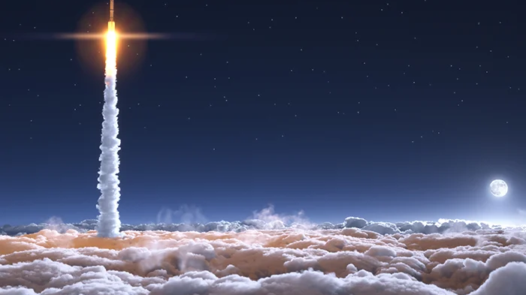
Used relational database PostgreSQL to load the final production database.
Below process was followed.
Created another 2 DF’s to act as connection between these DF’s by reading data from csv & API both
Bridge – Holds the ids from Launches, Rocket, Launchpads & Payloads.
Launch_cap – Holds ids from Launches & Capsules.
Created database Mission_SpaceX with the help of interface & schema with the SQL queries in pgAdmin4.
Using SQL Alchemy loaded all the DF’s to tables below:
Capsule
Rocket
Payload
Launches
Launchpad
Launch_cap
Bridge
Retrieved the loaded data from above created SQL tables for verification.
L
O
A
D

Slide 6


